Slide 1

TRANSFER FILES - Sliding window protocol
DOCUMENTATIE RETELE SI CALCULATOARE, ECHIPA:
BACIU H. ALEXANDRU
CORDUNEANU VLAD

Slide 2
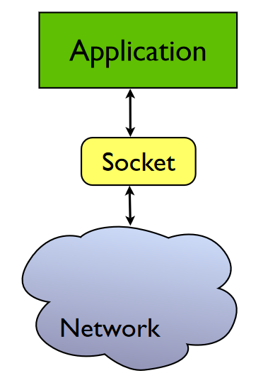
What are Berkeley sockets?
Berkeley sockets is an application programming interface (API) for Internet sockets and Unix domain sockets, used for inter-process communication (IPC). It is commonly implemented as a library of linkable modules.
A socket is an abstract representation (handle) for the local endpoint of a network Communication path. The Berkeley sockets API represents it as a file descriptor (file handle). In the Unix philosophy that provides a common interface for input and output to streams of data.
The Berkeley socket API typically provides the following functions: https://en.wikipedia.org/wiki/Berkeley_sockets#Socket_API_functions

Slide 3
What is UDP?
In computer networking, the User Datagram Protocol (UDP) is one of the core members of the Internet protocol suite. With UDP, computer applications can send messages, in this case referred to as datagrams, to other hosts on an Internet Protocol (IP) network. Prior communications are not required in order to set up communication channels or data paths.
UDP uses a simple connectionless communication model with a minimum of protocol mechanisms. UDP provides checksums for data integrity, and port numbers for addressing different functions at the source and destination of the datagram. It has no handshaking dialogues, and thus exposes the user's program to any unreliability of the underlying network; there is no guarantee of delivery, ordering, or duplicate protection.
UDP is suitable for purposes where error checking and correction are either not necessary or are performed in the application; UDP avoids the overhead of such processing in the protocol stack. Time-sensitive applications often use UDP because dropping packets is preferable to waiting for packets delayed due to retransmission, which may not be an option in a real-time system.

Slide 4
What is TCP flow control?
TCP is the protocol that guarantees we can have a reliable communication channel over an unreliable network. When we send data from a node to another, packets can be lost, they can arrive out of order, the network can be congested or the receiver node can be overloaded.
When we are writing an application, though, we usually don’t need to deal with this complexity, we just write some data to a socket and TCP makes sure the packets are delivered correctly to the receiver node.
Another important service that TCP provides is what is called Flow Control. Let’s talk about what that means and how TCP does its magic.
Flow Control basically means that TCP will ensure that a sender is not overwhelming a receiver by sending packets faster than it can consume. The idea is that a node receiving data will send some kind of feedback to the node sending the data to let it know about its current condition.

Slide 5
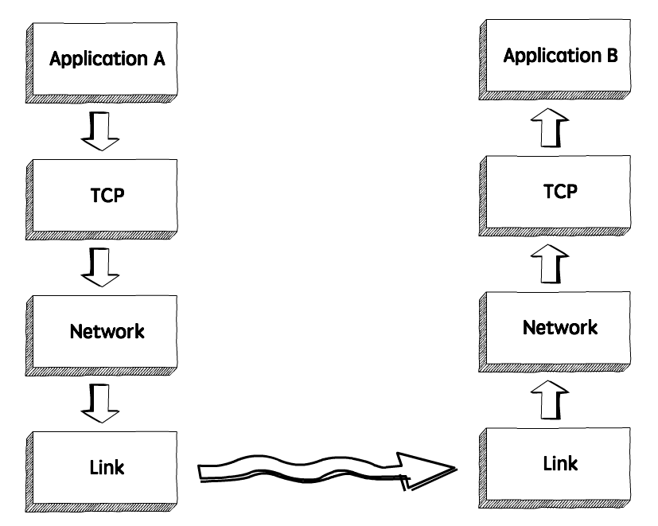
How TCP Flow Control works?
When we need to send data over a network, this is normally what happens:
The sender application writes data to a socket, the transport layer (in our case, TCP) will wrap this data in a segment and hand it to the network layer (e.g. IP), that will somehow route this packet to the receiving node.
On the other side of this communication, the network layer will deliver this piece of data to TCP, that will make it available to the receiver application as an exact copy of the data sent, meaning if will not deliver packets out of order, and will wait for a retransmission in case it notices a gap in the byte stream.

Slide 6
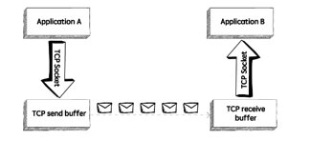
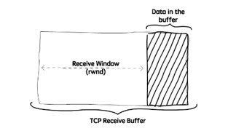
How TCP Flow Control works?
If we zoom in, we will see something like in the upper image.
TCP stores the data it needs to send in the send buffer, and the data it receives in the receive buffer. When the application is ready, it will then read data from the receive buffer.
Flow Control is all about making sure we don’t send more packets when the receive buffer is already full, as the receiver wouldn’t be able to handle them and would need to drop these packets.
To control the amount of data that TCP can send, the receiver will advertise its Receive Window (rwnd), that is, the spare room in the receive buffer.
Every time TCP receives a packet, it needs to send an ack message to the sender, acknowledging it received that packet correctly, and with this ack message it sends the value of the current receive window, so the sender knows if it can keep sending data.

Slide 7
Frames
In the OSI model of computer networking, a frame is the protocol data unit at the data link layer. Frames are the result of the final layer of encapsulation before the data is transmitted over the physical layer.
A frame is "the unit of transmission in a link layer protocol, and consists of a link layer header followed by a packet." Each frame is separated from the next by an interframe gap.
A frame is a series of bits generally composed of frame synchronization bits, the packet payload, and a frame check sequence.

Slide 8
Packs
It turns out that everything you do on the Internet involves packets. For example, every Web page that you receive comes as a series of packets, and every e-mail you send leaves as a series of packets. Networks that ship data around in small packets are called packet switched networks.
On the Internet, the network breaks an e-mail message into parts of a certain size in bytes. These are the packets. Each packet carries the information that will help it get to its destination – the sender's IP address, the intended receiver's IP address, something that tells the network how many packets this e-mail message has been broken into and the number of this particular packet. The packets carry the data in the protocols that the Internet uses: Transmission Control Protocol/Internet Protocol (TCP/IP).
Each packet contains part of the body of your message. A typical packet contains perhaps 1,000 or 1,500 bytes. Each packet is then sent off to its destination by the best available route -- a route that might be taken by all the other packets in the message or by none of the other packets in the message. This makes the network more efficient. First, the network can balance the load across various pieces of equipment on a millisecond-by-millisecond basis. Second, if there is a problem with one piece of equipment in the network while a message is being transferred, packets can be routed around the problem, ensuring the delivery of the entire message. Depending on the type of network, packets may be referred to by another name: Frame block cell Segment
https://computer.howstuffworks.com/question5251.htm

Slide 9
How we will do it
Technically we have to implement the principles of the SLIDING WINDOW protocol in our own software (the buffers, what information the packages will contain and the logic behind the sending (for both the sender and the receiver).
First we have to establish an UDP connection using sockets between the instances of the app and then manage the behavior of the transmission via the app itself.
We will have 2 buffers (one for sender, one for receiver). First, the connection will be established. During this, the receiver will inform the sender about the buffer dimension. After this, the sender will start sending the packages according to the sliding window protocol. The receiver will send an acknowledgement for each package received and this will contain the number of last correct package and the dimension of the available buffer. The sender will modify its sending rate according to the information received in the last acknowledgement . The sender will try for a defined time period to test if the receiver is ready to get messages again.
To test if the application work perfectly we will use rand to generate a false acknowledgement.
http://www.ccs-labs.org/teaching/rn/animations/gbn_sr/ - describes how it should work

Slide 10
Big picture of the project
The present application implements the TCP Flow Control with Sliding Window Transfer Protocol via UDP sockets. Our app has to modes to start: Sender and Receiver. In the Sender state the user can select a file to transfer and in the Receiver instance the user can start the receiving process. To select the state and run the program in a correct a way the user must introduce in the command line the state he wishes to start the app (“sender” or “receiver”). Any other parameters will give an error. Only one transfer at a time can be made in the application. The architecture is divided in two main components: GUI and Controller. Also the controller has 2 modules : the frames generator and the transmission layers. The transmission layers are the TCP with Flow Control and the UDP sockets. As a separate module the program uses a logger to display messages on the interfaces and also stores this messages in two separate files corresponding to the running state.

Slide 11
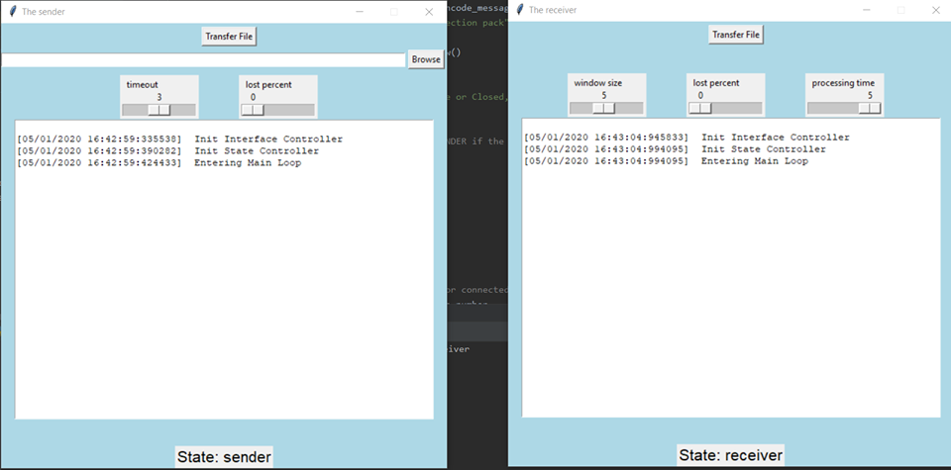
Creating Interface

Slide 12
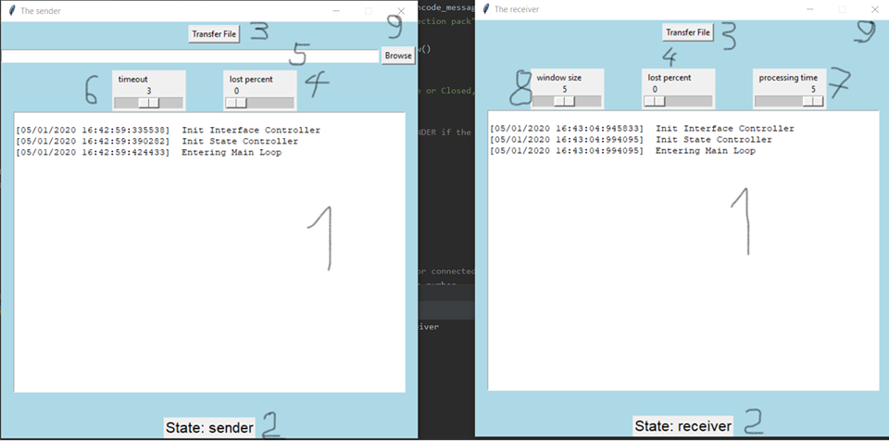
Creating Interface
1. Text box where the logger messages are displayed while the program is running.
2. A label that shows the state of the instance.
3. The button that triggers the transfer process. It has to be pressed on both sides for the transfer to start.
4. A slider to choose the loss rate of transferred packages for each instance.
5. The browse bar and browse button to select the file to transfer.
6. A slider to choose the timeout for the sender (in seconds).
7. A slider to choose the average processing time of each received package
8. A slider to choose the Sliding Window size.
9. The close button. First press kills the transfer if it is running and second the app itself.

Slide 13
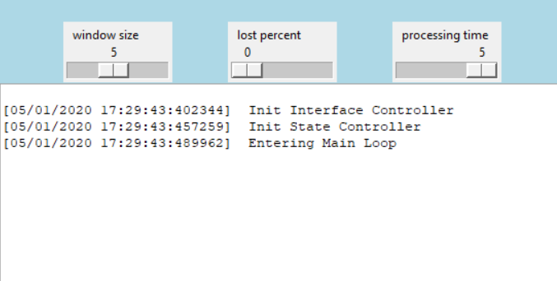
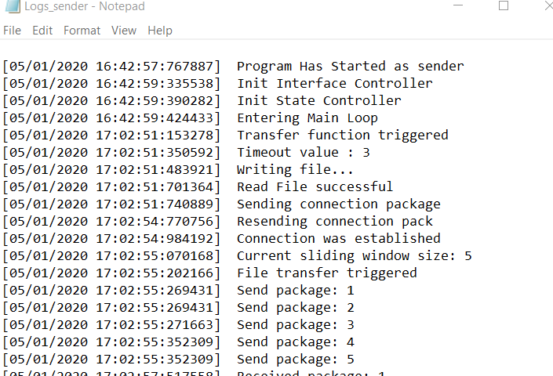
Creating Logger
The Logger is a singleton class which deals displaying and storing the message generated during runtime in a synchronized way. It knows in which state the app is and stores logs differently according to it in two separate files: “Logs_receiver” and “Logs_sender”. Every message is created by adding the datetime and the text message. The logger is available from all over the project and the singleton method secure that is unique. It is thread safe, only one thread having access to write on the display and in the file at a time.

Slide 14
Creating Controller
The controller connects the interface controls with the rest of the modules. It also contains the two transmission layers which we will talk about in the next slides. It`s purpose is to manage the relationship between the modules and to store all the important variables of the program. Among this variables are the threads that execute the work of transferring layer. When the transfer button from the interface is triggered a new thread is started. It will control the TCP layer. For the UDP layer two threads are started at the launching of the app: one responsible to receive messages and one to send messages for both instances. It also contains variables responsible with synchronizing the layers and the threads.

Slide 15
Implementing UDP layer
It is responsible with sending and receiving messages without any confirmation. Each instance has 2 components: the sender and the receiver. They are started when the controller is instanced. Each one runs on a separated thread independent from the rest of the program. The sender of each instance is connected with the receiver of the other via Berkley sockets. The sockets are configured on the 5005 and 5006 ports on the localhost. Each one has a buffer(receive and transmit buffer) to communicate with the TCP layer. Basically the sender is in a loop which verifies if the transmit buffer contains something. In this case it transmits the message via the socket. The receiver is in a loop that waits for messages and when one message is received it will be stored in the receive buffer. The loss of packages is implemented in the sender which calculates the probability to lose the package and decides if to send the message or not, simulating the loss of messages from transmiting.

Slide 16
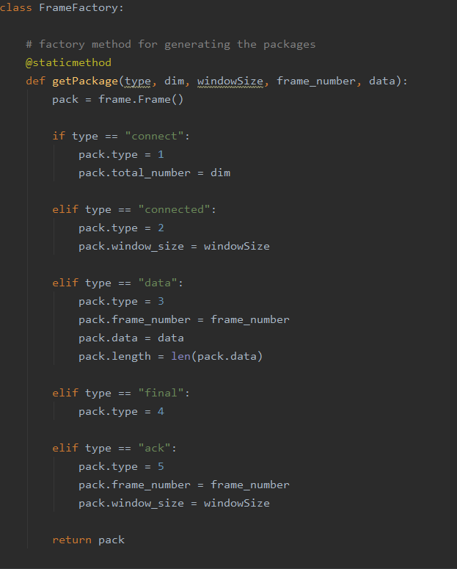
Implementing a module for packing data
This module has a factory that generates frames of different types: connect, connected, data, final and acknowledged.
Frame is a class that hides the logic of encoding and decoding messages. This messages are written in byte arrays and use some specials characters to pack the information of a message(type, length, window size, number of packages, data, etc.)
When a frame is sent or received by the TCP layer this class methods ensure a correct encode and decode for each type of frame.

Slide 17
Implementing logic for TCP transmitter
The logic is implemented as a finite states machine. The states of the transmitter are: connecting, transferring with waiting and sending and finished. Before connecting the file to be transferred is read and then it is divided in frames prepared to be send.
Connecting: in this state we try to establish a connection between transmitter and receiver. The transmitter sends a connection pack and waits for the receiver to respond. In case of a lost frame it will timeout and retry the sending. After 10 retries it will abort the transmission. In case of success it will move to the transferring state.
Transferring: here it will start with sending data packages according to the window size received from the connection response. After sending the packages it will wait for acknowledge and will modify it`s windows according with what it received. If the window size permits, it will send the next packages. In case of loses it will resend all the window packages from last correct received acknowledge after a timeout. In case of finish it will move to the finished state.
Finished: it will send a package to inform the receiver that the transfer is finished after which it will close itself. This package is not mandatory as the receiver is informed in the connection package about the number of frames to receive.

Slide 18
Implementing logic for TCP receiver
The logic is implemented as a finite states machine. The states of the receiver are: listening, receiving with waiting and sending ack, and finished. Before starting listening the receiver gets from interfaces value for window size and processing time for a package.
Listening: the receiver awaits for a connection package and in case of receiving one it will send an ack with window size. In case of no response it will abort the receiving after 10 seconds. If the connection is established successful the receiver step into the receiving state.
Receiving: it will wait for packages and in case it receive something checks the pack to be the awaited one. If it correct it will generate a process time after which It will send and ack else it will send an ack with last correct received pack. In case of no response for 10 seconds it will abort the receive. If all the awaited packages are received or it receives the ending package it will move to the finished state.
Finished: Checks if all the packages were received and decides if transmission was successful. If it was done correctly the messages will be decoded and displayed into log and text box of the receiver instance else it will show a transfer failed message and the received packages until failed triggered.

Slide 19
Implementing TCP Flow Control with Sliding Window
The flow control was implemented as a solution for sender to not overwhelm the receiver. For this the sender will modify its window size according to the size received in the last ack package. This window size is calculated by the receiver corresponding to the last process time.
The sliding window helps with sending more packages without an ack but with the benefits of TCP Protocol regarding the safety of the transfer. It will send all packages in the frame and it will wait for ack to move the window and send next packages. In case of failed transmissions it will resend all the packages in the present window after a timeout. In this implementation the packages have to come in order for them to be recognized as the correct packages as in go back n implementation

Slide 20
Technology used and team play
Programming:
Python 3.8 with Pycharm Community IDE
Tkinter as a library for GUI
Sockets library as wrapper for Berkeley sockets
Threading for parallel processing
Organizing the team
GitHub to store the project and for versioning control
SourceTree to manage the Git repository(main branches master)
Trello for task management
Google drive to store auxiliary files of the project

